Slide 1
Ch. 5: United States West of the Mississippi
Lesson1: Physical Geography
Lesson2: History

Slide 2
Lesson 1: Physical Geography
Most of what you need to know for the test about the physical geography portion of chapter 5 is from your map. The following is in addition to those notes.

Slide 3
Climate
The United States west of the Mississippi River has many different climates.
Tropical Rain Forests cover parts of Washington and Oregon
Many storms com from the North Pacific
Dry, hot deserts cover large parts of the Southwest
Coastal and Highland Climates
Located in the mountains on the West Coast
Climates in the Interior
The high mountains of the Cascades and the Sierra Nevada produce a rain shadow effect that keeps the interior of the region dry
The western Great Plains have a semiarid climate

Slide 4
Resources
Energy Resources
Petroleum and Natural Gas
Louisiana and Texas, the southern Great Plains, California, and Alaska
Coal is found in Wyoming
Ethanol: a liquid fuel made from plants
Hydroelectric power is found along the Columbia and Colorado Rivers
Wind Power
Solar Power

Slide 5
Minerals and Other Resources
The Rocky Mountains are important sources of gold, silver, copper, zinc, and lead.
Timber is also an important resource
Fertile soil makes the Plains, California, and parts of Oregon and Washington major farming regions
Many national parks that attract millions of visitors every year

Slide 6
Chapter 5 Lesson 2
The following slides will be about the history of this area

Slide 7
Native Americans
The Tribes of the Great Plains
Some farmed and hunted. They settled along rivers where they grew corn, squash and other foods
Others hunted the herds. They were nomads
Pueblo People of the Southwest
Lived in villages that the Spanish called pueblos (towns or villages)
Homes were made of dried mud.
They dry farmed: grew corn, beans, and squash

Slide 8
Native Americans cont.
Northwest Native Americans
Fished for salmon and hunted sea mamamals.
Built large homes of wood

Slide 9
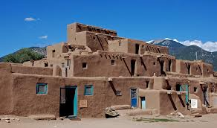
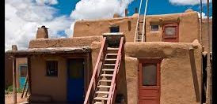
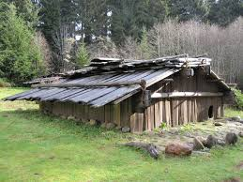
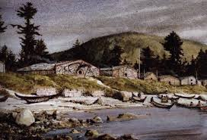

Slide 10
Spanish
The Spanish were the first Europeans to come to the region
Settled near what is now El Paso, Texas
By 1600 they had founded Santa Fe, NM and spread out along the upper reaches of the Rio Grande
1700’s they settled parts of California
They created missions: church based communities led by Catholic priests meant to house native peoples.
Introduced many crops that were grown in Spain but not the U.S.
Oranges, grapes, apples, peaches, pears and olives
They also adopted many crops that did not grown in Spain
Corn, Tomatoes, and avocados

Slide 11
French
In the 1680’s France claimed the land drained by the Mississippi, which included much of the land east of the Rocky Mountains
They called this land Louisiana
They also had settlements along the Mississippi River.
The most important settlement was New Orleans.
This was a port for shipping goods from the river’s valley

Slide 12
Westward Expansion
https://www.youtube.com/watch?v=NbwVl-0AP6s

Slide 13
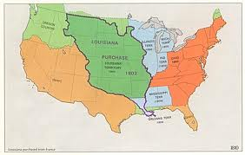
Westward Expansion cont
In 1803 President Thomas Jefferson purchased the vast Louisiana Territory from France. This gave the United States most of the land between the Mississippi River and the Rocky Mountains

Slide 14
Westward Expansion cont.
In the 1830’s many Americans had come to believe in the idea of Manifest Destiny
This is the idea that the U.S. had a right to extend its boundaries to the Pacific Ocean
Many settlers moved to the rich farmlands in what is now Oregon.
This area was occupied by both the British and the Americans so in 1846 they came up with an agreement which gave the US the states and Britain parts of Canada
Other settlers moved to what is now Texas
This was owned by Mexico and after Mexico became independent the United States annexed, took control of, Texas

Slide 15
Western Expansion Cont.
Some Americans hoped to gain California and other lands
These were part of Mexico
This led to a war which the US won
The Treaty of Guadalupe Hidalgo gave the US California, Utah, and Nevada and parts of Colorado, Arizona, Wyoming, and New Mexico

Slide 16
Expansion in the 1800’s
https://www.youtube.com/watch?v=Q16OZkgSXfM

Slide 17
Gaining New Lands
During the late 1800’s, the United States made its last land acquisitions.
The first was Alaska
In 1867, the United States purchased Alaska from Russia for just over $7 million
This ended up being about two cents per acre
This was not a popular decision at first but then gold and copper were found
Hawaii
Businesspeople began to grow sugar in Hawaii in the late 1800’s
They were afraid that the royal family would take away the power and land they had acquired.
The business people then seized the government and requested that the United States annex Hawaii.
In 1900, the government agreed to do so

